Slide 1
Liking and Credibility

Slide 2
The Power of Being Likable (and Believable)
People who are likable (aka, “charming”) are more persuasive than unlikable people.
What type of personal characteristics make you like someone?
People who are highly credible are also much more persuasive than those who are not.
What makes one person more believable than another?

Slide 3
Today’s lecture
The components of liking
The power of reciprocal liking
Basic principles of balance theory
Dimensions of credibility
Effects of credibility on persuasion
The halo effect and the sleeper effect
How you can enhance your credibility

Slide 4
The components of liking
Physical attractiveness
Similarity
Flattery
Repeated contact
Conditioning/Association

Slide 5
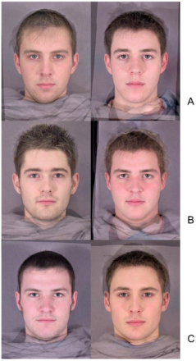
Components of Liking: Physical Attractiveness
Physical attractiveness includes:
Height (especially for men)
Weight (especially for women)
Facial features
Grooming/dress
Signs/symbols of higher socioeconomic status.
Physically attractive people have more attractive romantic partners and get better, higher paying jobs than unattractive people.

Slide 6

Components of Liking: Similarity
“Birds of a Feather” vs. “Opposites Attract”?
We are more attracted to people who are similar to ourselves.
We tend to have romantic partners of similar social class backgrounds and who have similar values, as well as a similar level of physical attractiveness.
eHarmony and other online dating sites tend to emphasize trait similarity.

Slide 7

Components of Liking: Flattery
Giving compliments is often an effective way to increase your likeability (and by extension, your persuasiveness).
Even if people know what you’re up to, flattery is still effective.

Slide 8

Components of Liking: Repeated Contact/Association
We prefer people who are familiar to us over those who are strangers.
Even one previous meeting increases liking.

Slide 9
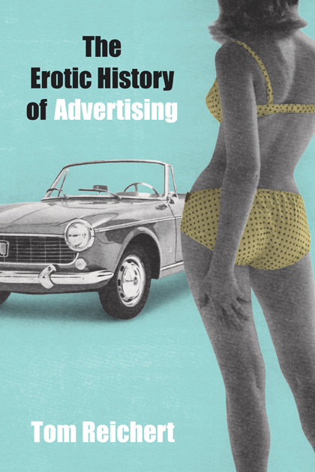
Components of Liking: Conditioning and Association
The mere association between a person and something (or someone) with positive or negative traits will affect how we see that person.
Excitation transfer theory: Context plays a role in liking
Sex and advertising works on a principle of association.
Disliking is just as powerful as liking when it comes to persuasion.
Ann Coulter likes to refer to “Hussein” Obama (:47)

Slide 10
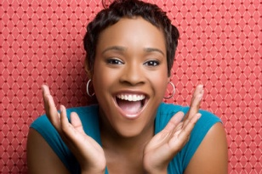
Emotional contagion
We like people who make us feel the way we WANT to feel.
Usually, but not always, we’d like to feel happy.
However, it is a sign of liking when you “mirror” the other person.
Also called convergence.
This means that people who are “too happy” can be annoying when they don’t adapt to people around them.

Slide 11
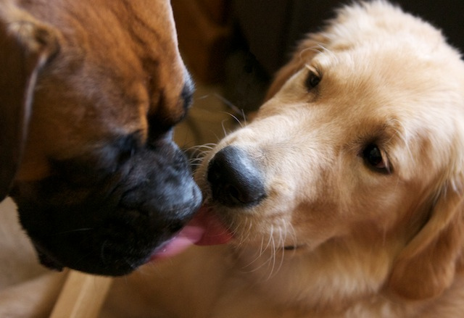
Reciprocal Liking
We like people who have expressed their liking for us.
When we believe that someone likes us, we are less likely to express conflict when we have to cooperate on tasks.
Applications for work environments?

Slide 12
Balance Theory: Heider, 1958
We work to achieve balance in our relationships.
We like our friends to like our other friends.
We like our friends to (dis)like the things we (dis)like.
If either is out of balance, we feel dissonance.
We will try to influence people close to us to feel the same way we do.
Object
+/-
+/-
You
Other
+/-

Slide 13
Are you “in balance” with others?
To see if you are “in balance” or “unbalanced,” multiply the signs. If the signs are positive, they’re in balance. If they are negative, they are out of balance. Example:
Object
Object
+
+
-
-
You
+
Other
You
-
Other
Balanced
Unbalanced

Slide 14
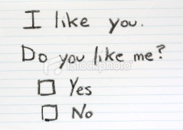
Applications
How have you applied principles of liking to persuade others?
Tupperware parties: We buy from people we know and like.
How to Make People to Like You

Slide 15
Credibility
Credibility is another variable that affects persuasion that is a characteristic of the source.
Credibility is the #1 factor in persuasion.

Slide 16
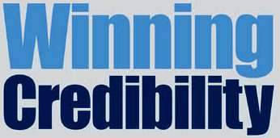
Credibility
Credibility is a person’s “believability” and their ability to inspire trust.
Although credibility is a characteristic of the source (or the speaker), it is conferred by the audience.
In other words, you can’t say (with certainty) “I’m credible.” Only your audience can say, “This person is credible.”

Slide 17
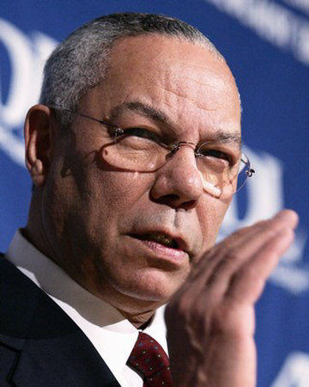
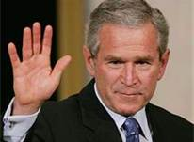
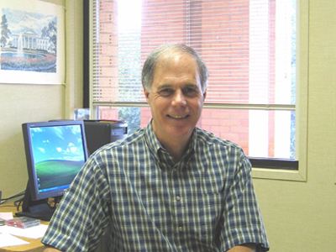
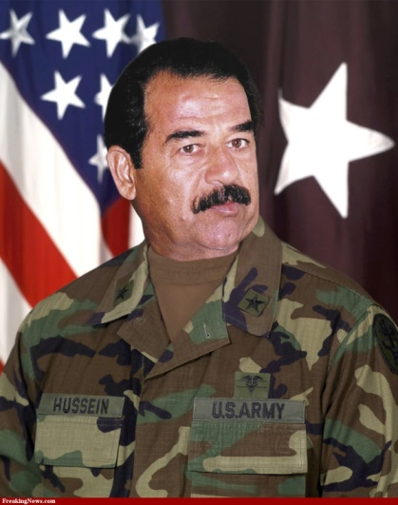
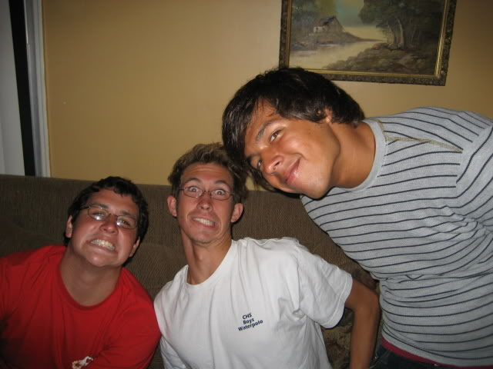
Credibility
How credible are the following in discussing the war on Iraq? Why?
George W. Bush
Colin Powell
Saddam Hussein
A political science professor
Your friends

Slide 18
Credibility is Multidmensional
Lots of characteristics can contribute to someone’s credibility (or hurt it).
The most important characteristics are called the “primary dimension.”
There are other characteristics that are still somewhat important. These form the “secondary dimension” of credibility.

Slide 19
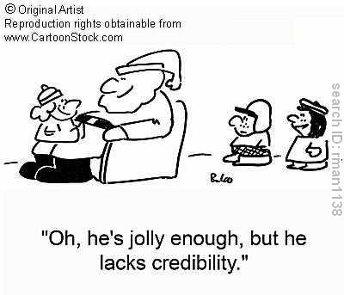
Primary dimensions of credibility
Competence/Expertise
Experienced, informed, trained, skilled, intelligent, expert
Character/Trustworthiness
Honest, trustworthy, fair, just, unselfish
Goodwill
Cares about me
Wants the best for me
What’s Santa’s problem?

Slide 20
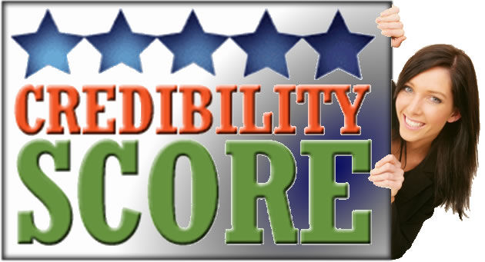
Secondary dimensions of credibility
Composure
Poised, relaxed, calm, composed
Sociability
Good-natured, cheerful, friendly
Extroversion
Bold, verbal, aggressive, talkative

Slide 21
How does liking impact credibility?
http://www.youtube.com/watch?v=PEQOBBgcG5E
What’s the relationship between liking and trust?
How does nonverbal communication impact liking and trust (credibility)?

Slide 22

Facts about Credibility
Credibility changes depending on the audience and the situation.
Credibility is dynamic: you can gain or lose it.
Credibility is a heuristic or peripheral cue we use under conditions of low motivation or ability (ELM).
If we are motivated and able, credibility is only one component we consider.

Slide 23

The Halo Effect
The “halo effect” happens when credibility that we have in one area carries over and helps us be persuasive in an unrelated area.
An actor from a daytime serial (“soap opera”) appeared in a 1986 commercial for cough syrup.
http://www.bing.com/videos/search?q=I%27m+not+a+doctor+but+I+play+one+on+TV&view=detail&mid=BFC5A23D63FD46DDAF2FBFC5A23D63FD46DDAF2F&first=0
+ Celebrity endorsements for political candidates

Slide 24
Use of signs and symbols to increase credibility
“United States Prescription Savings Card.”

Slide 25
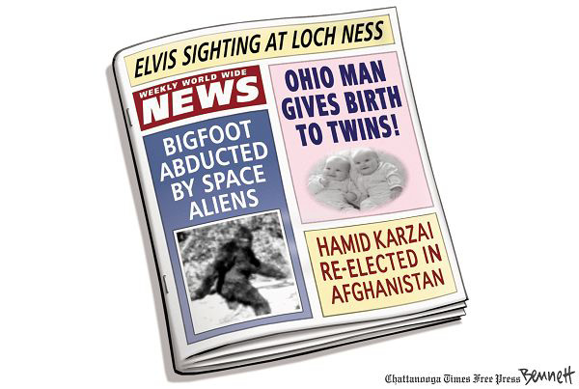
The Sleeper Effect (Hovland & Weiss, 1951)
The Sleeper Effect refers to the phenomenon of attributing credibility to a very low credibility source as time passes.
We tend to forget important credibility cues over time, particularly if we’re not aware of them before we hear the information.

Slide 26
Sleeper Effect, continued
Immediately after a persuasive communication event:
A high-credibility source will create more positive attitudes toward the issue.
A low credibility source will produce less-favorable attitudes toward the issue than the audience originally had (discounting cues).
High credibility messages lose impact over time.
Over time, in low credibility messages, audiences disassociate the source of the message from the message itself and attitudes become more favorable.

Slide 27
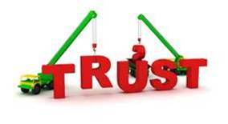
How to Build (or Enhance) Your Credibility
Be prepared
Cite evidence
Explain expertise
Build trust
Adapt language
Speak powerfully
Increase involvement
Have credible source endorse you
The above tips apply only when speaking to people who don’t know you. Otherwise, your reputation (credibility) will precede you.

